Slide 1
AZ-104T00A Administer Azure Resources
Notes:
These Learn modules are part of the AZ-104: Prerequisites for Azure administrators (https://docs.microsoft.com/learn/paths/az-104-administrator-prerequisites/learning path.

Slide 2
Administer Azure Resources Introduction
Configure Azure Resources with Tools
Configure Resources with ARM Templates
Lab 03b - Manage Azure resources by Using ARM Templates
Lab 03c - Manage Azure resources by Using Azure PowerShell (optional)
Lab 03d - Manage Azure resources by Using Azure CLI (optional)
Notes:
Covered in Module 02 - Lab 03a - Manage Azure resources by Using the Azure Portal. Focus on other tools.

Slide 3
Administrator Resources whiteboard and review
What other tools do you use?
Storage
Storage Explorer
Data Box
Import/Export service
AzCopy
Daily management
Azure portal
Azure Resource Manager templates
Azure policy
Azure backup
Bicep
Cloud Shell
CLI
PowerShell
Networks
Network Watcher
Administrator tools
Virtual machines
Azure Backup
Bastion
RDP
SSH
App Services
Application Insights
Notes:
Optional whiteboard slide to introduce the module or review the content. Use the whiteboard diagram directly or recreate the image during the class.
Name at least three tools an Administrator can use on a day-to-day basis to manage Azure resources.
Answer: Azure Portal, Azure CLI, Azure PowerShell, and Azure templates.
What are Azure Resource Manager templates and what are the advantages of using them?
Answer: Templates are a programmatic way to define your infrastructure with code. Templates let you create and deploy resources in a consistent manner. Templates improve accuracy and reduce manual errors. Templates can be reused and simplify administration. Templates have a defined schema and use a declarative syntax.
How are ARM templates different from Bicep?
Answer: Bicep is a transparent abstraction over the ARM template JSON. During deployment, the Bicep CLI converts a Bicep file into the ARM template JSON. All resources in the ARM template are valid in a Bicep file. You can use Bicep instead of JSON for developing your templates.
Why would you use the Azure portal instead of a programming language like CLI?
Answer: The Azure portal is a good tool when you are first starting out as an Administrator. The portal is menu-driven with easy-to-use wizards. In the portal you don’t need to know a programming syntax. However, when you have tasks that must be repeated (scripted) a command language like PowerShell or the CLI is better than the portal.
Describe the Azure Cloud Shell and the two programming languages it supports.
Answer: The Azure Cloud Shell Interactive, browser-accessible shell. The shell offers coding in either Azure CLI or Azure PowerShell. The shell Is temporary and provided on a per-session, per-user basis. The shell requires a resource group, storage account, and Azure File share. When you use the shell, it authenticates automatically and times out after 20 minutes.

Slide 4
Configure Azure Resources with Tools

Slide 5
Configure Azure Resources with Tools Introduction
Compare Administration tools (4 student topics)
Demonstration – Azure Portal
Demonstration – Azure Cloud Shell
Summary and Resources
Notes:
This section is not directly related to any certification objectives. However, using the tools will be necessary to complete any hands-on portion of the exam.

Slide 6
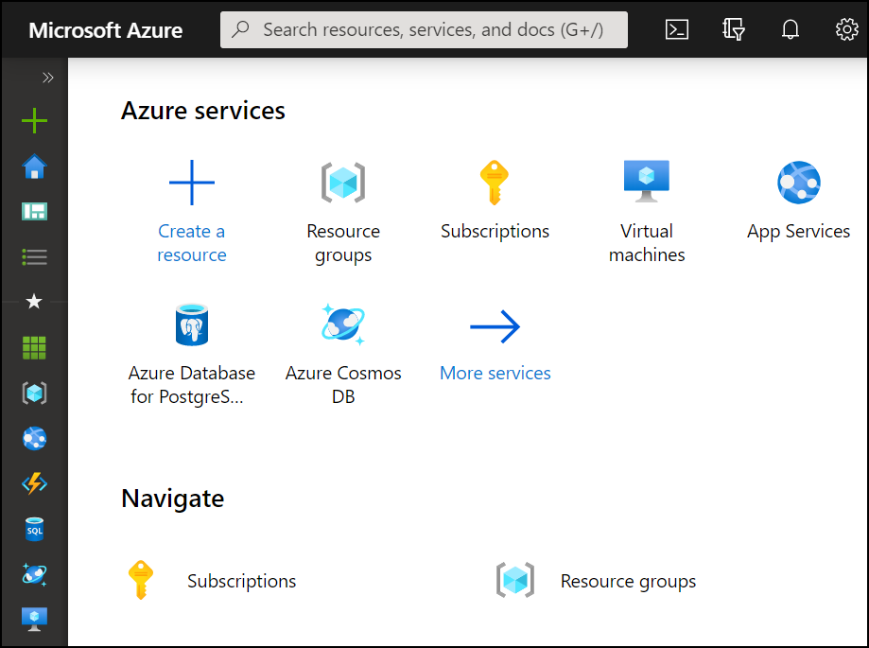
Compare Administrator tools
Azure Portal
View and manage resources Visual interface Unified hub – training and documentation Personalize your experience Mobile app Access the Cloud Shell One-off creation scenarios
Azure Cloud Shell
Interactive and browser-accessible Offers Bash or PowerShell Authenticates automatically Provided on a per-session and per-user basis Temporary - times out after 20 minutes
Azure PowerShell and CLI
Command line programs Interactive and scripting modes Cross-platform Good for repeatable deployments Familiar coding experience
az vm restart -g MyResourceGroup -n MyVm
Notes:
The student content has a page for each tool. This is a summary comparison. The extra slides that were removed are at the end of the presentation.
Azure Portal Overview - https://docs.microsoft.com/azure/azure-portal/azure-portal-overview
Overview of Azure Cloud Shell - https://docs.microsoft.com/azure/cloud-shell/overview
Get started with Azure PowerShell - https://docs.microsoft.com/powershell/azure/get-started-azureps?view=azps-4.3.0
Get started with Azure CLI - https://docs.microsoft.com/cli/azure/get-started-with-azure-cli?view=azure-cli-latest

Slide 7
Demonstration – Azure Portal
Help and keyboard shortcuts
Customizing your experience
Notes:
Manage Azure portal settings and preferences - https://docs.microsoft.com/azure/azure-portal/set-preferences
Create a dashboard in the Azure portal - https://docs.microsoft.com/azure/azure-portal/azure-portal-dashboards
How to create an Azure support request - https://docs.microsoft.com/azure/azure-portal/supportability/how-to-create-azure-support-request

Slide 8
Demonstration – Cloud Shell
Configure the Cloud Shell
Experiment with Azure PowerShell
Experiment with Bash shell
Experiment with the Cloud Editor
Notes:
Quickstart for Azure Cloud Shell - https://learn.microsoft.com/en-us/azure/cloud-shell/quickstart?tabs=azurecli

Slide 9
Summary and Resources – Configure Azure Resources with Tools
Knowledge Check Questions
Microsoft Learn Modules (docs.microsoft.com/Learn)
Manage services with the Azure portal (Sandbox)
Introduction to PowerShell (Sandbox)
Control Azure services with the CLI (Sandbox)
Control and organize Azure resources with Azure Resource Manager
A sandbox indicates a hands-on exercise.
Notes:
Learn - https://docs.microsoft.com/learn/browse/
The Assessment Guide in the MCT DLC has open-ended questions.
Describe the Azure Cloud Shell and the two programming languages it supports.
Answer: The Azure Cloud Shell Interactive, browser-accessible shell. The shell offers coding in either Azure CLI or Azure PowerShell. The shell Is temporary and provided on a per-session, per-user basis. The shell requires a resource group, storage account, and Azure File share. When you use the shell it authenticates automatically and times out after 20 minutes.

Slide 10
Configure Resources with ARM Templates
Notes:
Deploy and manage Azure compute resources (20–25%)
Automate deployment of resources by using Azure Resource Manager (ARM) templates or Bicep files
Interpret an ARM template or a Bicep file
Modify an existing ARM template
Modify an existing Bicep file
Deploy resources by using an ARM template or a Bicep file
Export a deployment as an ARM template or compile a deployment as a Bicep file

Slide 11

Configure Resources with ARM Templates Introduction
Review ARM Template Advantages
Explore the JSON Template Schema
Explore the JSON Template Parameters
Consider Azure Bicep Files
Demonstration – QuickStart Templates
Demonstration – Run Templates with PowerShell (optional)
Summary and Resources
Notes:
Deploy and manage Azure compute resources (20–25%)
Automate deployment of resources by using templates
• Modify an ARM template
• Deploy a template
• Save a deployment as an ARM template

Slide 12
Review ARM Template Advantages
Improves consistency and promotes reuse
ARM
Template
Reduce manual, error prone, and repetitive tasks
Express complex deployments
Development
Express requirements through code
Production
Provides validation tasks
Modular and can be linked
Quality
Assurance
Simplifies orchestration
Notes:
What are ARM templates? - https://docs.microsoft.com/azure/azure-resource-manager/templates/overview

Slide 13
Explore the JSON Template Schema
Defines all the Resource manager resources in a deployment
{
"$schema": "http://schema.management.
azure.com/schemas/2019-04- 01/deploymentTemplate.json#",
"contentVersion": "",
"parameters": {},
"variables": {},
"functions": [],
"resources": [],
"outputs": {}
}
Written in JSON
A collection of key-value pairs
Each key is a string
Each value can be a string, number, Boolean expression, list of values, object
Notes:
Understand the structure and syntax of ARM templates - https://docs.microsoft.com/azure/azure-resource-manager/templates/template-syntax

Slide 14
Explore the JSON Template Parameters
Specify which values are configurable when the template runs
"parameters": {
"adminUsername": {
"type": "string",
"metadata": {
"description": "Username for the VM."
}
},
"adminPassword": {
"type": "securestring",
"metadata": {
"description": "Password for the VM."
}
}
}
This example has two parameters: one for a VM’s username (adminUsername), and one for its password (adminPassword)
Notes:
Parameters in Azure Resource Manager templates - https://docs.microsoft.com/azure/azure-resource-manager/templates/template-parameters

Slide 15

Consider Azure Bicep Files
Simpler syntax for writing templates
Bicep file
resource storageAccount 'Microsoft.Storage/storageAccounts@2021-01-01' = {
name: storageAccountName
location: location
tags: {
displayName: storageAccountName
}
kind: 'StorageV2'
sku: {
name: 'Standard_LRS'
} }
Smaller module files you can reference from a main template
Automatically detect dependencies between your resources
Visual Studio Code extension with validation and IntelliSense
Notes:
What is Bicep? - https://docs.microsoft.com/azure/azure-resource-manager/bicep/overview?tabs=bicep
Bicep playground - https://aka.ms/bicepdemo

Slide 16
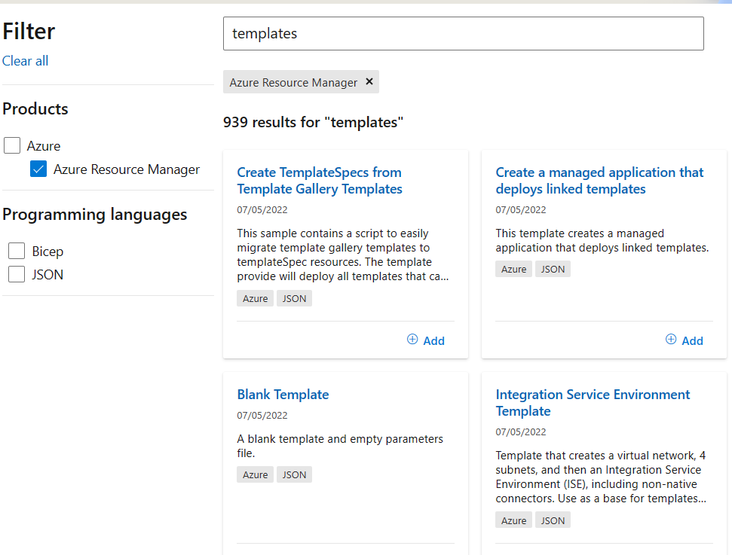
Demonstration - Quickstart templates
Explore the QuickStart gallery
Explore a template
Notes:
Tutorial - Create & deploy template - Azure Resource Manager - https://docs.microsoft.com/en-us/azure/azure-resource-manager/templates/template-tutorial-create-first-template?tabs=azure-powershell

Slide 17
Demonstration – Run Templates with PowerShell (optional)
Connect to your subscription
Create the resource group
Deploy the template into the resource group
Verify the template deployed
Notes:
Tutorial: Create and deploy your first ARM template - https://learn.microsoft.com/azure/azure-resource-manager/templates/template-tutorial-create-first-template?tabs=azure-powershell

Slide 18
Summary and Resources
Knowledge Check Questions
Microsoft Learn Modules (docs.microsoft.com/Learn)
Create Azure resources using Azure Resource Manager templates
Deploy Azure infrastructure by using JSON ARM templates (Sandbox)
Introduction to infrastructure as code using Bicep
Build your first Bicep template (Sandbox)
A sandbox indicates a hands-on exercise.
Notes:
Learn - https://docs.microsoft.com/learn/browse/ - There are a lot of other Learn modules on templates.
The Assessment Guide in the MCT DLC has open-ended questions.
What are Azure Resource Manager templates and what are the advantages of using them?
Answer: Templates are a programmatic way to define your infrastructure with code. Templates let you create and deploy resources in a consistent manner. Templates improve accuracy and reduce manual errors. Templates can be reused and simplify administration. Templates have a defined schema and uses a declarative syntax.
Name at least three tools an Administrator can use to create and manage Azure resources.
Answer: Azure Portal, Azure CLI, Azure PowerShell, and Azure templates.

Slide 19
Lab 03b - Manage Azure resources by Using ARM Templates Lab 03c - Manage Azure resources by Using Azure PowerShell (optional) Lab 03d - Manage Azure resources by Using Azure CLI (optional)
Notes:
Pick the lab(s) most appropriate for your audience. Lab 03a - Manage Azure resources by Using the Azure Portal was covered in Module 02.

Slide 20
Lab 03b – Manage Azure resources with templates
Lab scenario
Now that you explored the basic Azure administration capabilities associated with provisioning resources and organizing them based on resource groups by using the Azure portal, you need to carry out the equivalent task by using Azure Resource Manager templates
Objectives
Task 1: Review an ARM template for deployment of an Azure managed disk
Task 2: Create an Azure managed disk by using an ARM template
Task 3: Review the ARM template-based deployment of the managed disk
Next slide for an architecture diagram
Notes:
LAB 03b - Manage Azure resources by Using ARM Templates - ESTIMATED DURATION 20 MIN
GitHub Repository - https://microsoftlearning.github.io/AZ-104-MicrosoftAzureAdministrator/

Slide 21



Lab 03b – Architecture diagram
Task 1
Task 2
az104-03a-rg1
JSON
Edit Template
JSON
Deploy
az104-03b-rg1
Template
New Template
az104-03a-disk1
az104-03b-disk1

Slide 22
Lab 03c – Manage Azure resources with PowerShell (optional)
Lab scenario
Now that you explored the basic Azure administration capabilities associated with provisioning resources and organizing them based on resource groups by using the Azure portal and Azure Resource Manager templates, you want the equivalent tasks with Azure PowerShell. To avoid installing Azure PowerShell modules, you will leverage the Azure Cloud Shell
Objectives
Task 1: Start a PowerShell session in Azure Cloud Shell
Task 2: Create a resource group and an Azure managed disk with Azure PowerShell
Task 3: Configure the managed disk by using Azure PowerShell
Next slide for an architecture diagram
Notes:
LAB 03c - Manage Azure resources by Using Azure PowerShell - ESTIMATED DURATION 20 MIN
GitHub Repository - https://microsoftlearning.github.io/AZ-104-MicrosoftAzureAdministrator/

Slide 23
Lab 03c – Architecture diagram
Task 1, Task 2, Task 3
az104-03c-rg1
az104-03c-disk1

Slide 24
Lab 03d – Manage Azure resources with the Azure CLI (optional)
Lab scenario
Now that you explored the basic Azure administration capabilities associated with provisioning resources and organizing them based on resource groups by using the Azure portal, Azure Resource Manager templates, and Azure PowerShell, you need to carry out the equivalent task by using Azure CLI. To avoid installing Azure CLI, you will leverage Bash environment available in Azure Cloud Shell
Objectives
Task 1: Start a Bash session in Azure Cloud Shell
Task 2: Create a resource group and a managed disk by using Azure CLI
Task 3: Configure the managed disk by using Azure CLI
Next slide for an architecture diagram
Notes:
LAB 03d - Manage Azure resources by Using Azure CLI - ESTIMATED DURATION 20 MIN
GitHub Repository - https://microsoftlearning.github.io/AZ-104-MicrosoftAzureAdministrator/

Slide 25
Lab 03d – Architecture diagram
Task 1, Task 2, Task 3
az104-03d-rg1
az104-03d-disk1

Slide 26

End of presentation

Slide 27
Review PowerShell Cmdlets and Modules
Get-Module
# Output
ModuleType Version Name
---------- ------- ----
Manifest 3.1.0.0 Microsoft.PowerShell.Management
Manifest 3.1.0.0 Microsoft.PowerShell.Utility
Binary 1.0.0.1 PackageManagement
Script 1.0.0.1 PowerShellGet
Script 2.0.0 PSReadline
Cmdlets follow a verb-noun naming convention; shipped in modules
Modules are a DLL file with the code to process each cmdlet
Load cmdlets by loading the module containing them
Use Get-Module to see a list of loaded modules
Notes:
Student Content
A PowerShell command is called a *cmdlet* (pronounced "command-let"). A *cmdlet* is a command that manipulates a single feature. The term cmdlet is intended to imply that it is a small command. By convention, cmdlet authors are encouraged to keep cmdlets simple and single purpose.
The base PowerShell product ships with cmdlets that work with features such as sessions and background jobs. You add modules to your PowerShell installation to get cmdlets that manipulate other features. For example, there are third-party modules to work with ftp, administer your operating system, and access the file system.
Cmdlets follow a verb-noun naming convention; for example, **Get-Process**, **Format-Table**, and **Start-Service**.
Verbs also have a convention. You can use **Get-Verb** to retrieve examples, such as:
- **get** retrieves data.
- **set** inserts or updates data.
- **format** formats data.
- **out** directs output to a destination.
Cmdlet authors are encouraged to include a help file for each cmdlet. The **Get-Help** cmdlet displays the help file for any cmdlet. For example, you could get help on the `Get-ChildItem` cmdlet with the following statement:
```powershell
Get-Help Get-ChildItem -detailed
```
Cmdlets are shipped in _modules. A *PowerShell module* is a DLL file that includes the code to process each available cmdlet. You load cmdlets into PowerShell by loading the module containing them. You can get a list of loaded modules using the `Get-Module` command:
```powershell
Get-Module
```
The 'Get-Module' command will output something like the following code:
```output
ModuleType Version Name ExportedCommands
---------- ------- ---- ----------------
Manifest 3.1.0.0 Microsoft.PowerShell.Management {Add-Computer, Add-Content, Checkpoint-Computer, Clear-Con...
Manifest 3.1.0.0 Microsoft.PowerShell.Utility {Add-Member, Add-Type, Clear-Variable, Compare-Object...}
Binary 1.0.0.1 PackageManagement {Find-Package, Find-PackageProvider, Get-Package, Get-Pack...
Script 1.0.0.1 PowerShellGet {Find-Command, Find-DscResource, Find-Module, Find-RoleCap...
Script 2.0.0 PSReadline {Get-PSReadLineKeyHandler, Get-PSReadLineOption, Remove-PS...
```

Slide 28
Use Azure Cloud Shell
Interactive, browser-accessible shell
Offers either Bash or PowerShell
Is temporary and provided on a per-session, per-user basis
Requires a resource group, storage account, and Azure File share
Authenticates automatically
Integrated graphical text editor
Is assigned one machine per user account
Times out after 20 minutes
Notes:
Overview of Azure Cloud Shell - https://docs.microsoft.com/azure/cloud-shell/overview

Slide 29
Use Azure PowerShell
New-AzVm `
-ResourceGroupName "CrmTestingResourceGroup" `
-Name "CrmUnitTests" `
-Image "UbuntuLTS" `
...
Connect to your Azure subscription and manage resources
Adds the Azure-specific commands
Available inside a browser via the Azure Cloud Shell
Available as a local installation on Linux, macOS, or Windows
Has an interactive and a scripting mode
Notes:
Get started with Azure PowerShell - https://docs.microsoft.com/powershell/azure/get-started-azureps?view=azps-4.3.0
Ask about the classes experience with PowerShell and Azure PowerShell.

Slide 30
Use Azure CLI
az vm restart -g MyResourceGroup -n MyVm
Cross-platform command-line program
Runs on Linux, macOS, and Windows
Can be used interactively or through scripts
Commands are structured in _groups_ and _subgroups_
Use find to locate commands
Use --help for more detailed information
Notes:
Get started with Azure CLI - https://docs.microsoft.com/cli/azure/get-started-with-azure-cli?view=azure-cli-latest
Ask about the students experience with CLI.

